Slide 1




GROUP 4 TEAM MEMBERS
Yash Panchal
CWID: 20011579
Section: A
Kirtana Sridharan
CWID: 20011879
Section: A
Riddhi Mahesh Dange
CWID: 20012299
Section: A
Akshay Bheda
CWID: 20011464
Section: A

Slide 2
CS 513 Knowledge Discovery and Data Mining
PREDICTING THE PRICE OF CALIFORNIA WINE

Slide 3
PROBLEM STATEMENT
Our project focuses on identifying the demand and fluctuation of prices of Californian wines by setting benchmarks and measuring the outcomes based on past trends. To support our findings, we will use the wine dataset to analyze and predict the increase/decrease in prices.
DATASET:
https://www.kaggle.com/datasets/jarredpriester/california-wine-production-19802020
Notes:
Aryan

Slide 4
DATA SET EXPLANATION
COLUMN NAME | DESCRIPTION | TYPE
Year | Production year of the wine | integer
CommodityCode | Code number for wine | integer
CropName | Name of the crop harvested | object
CountyCode | Numeric code to represent counties | integer
County | Name of the county | object
HarvestedAcres | Harvested Area in Acres | float
Yield(Unit/Acre) | Amount of agricultural production harvested per unit of land area | float
Production | Amount of wine produced | float
Price(Dollars/Unit) | Price of wine in USD | float
Unit | Unit of measurement = Tons | object
Value | Total value of the production | integer
Notes:
Aryan

Slide 5
PREPROCESSING
Dataset is preprocessed by removing rows consisting null values.
Price is selected as the target variable and is classified into labels 0, 1, 2 representing the categories Low, Medium, and High, respectively.
Feature Columns : Year, CountyCode, HarvestedAcres, Yield, Production
Target Variable : Price Categories
Min-Max Scaler is used to transform features by scaling each feature.
Notes:
Aryan

Slide 6
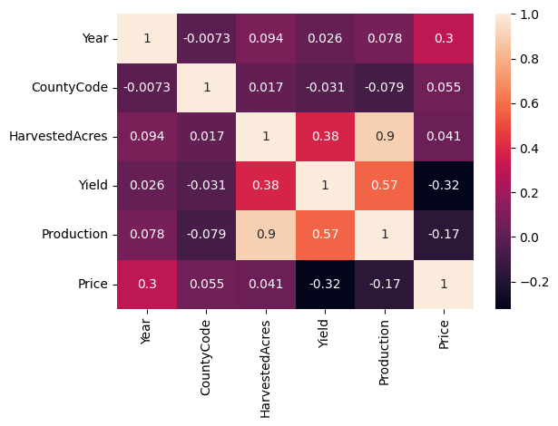
CORRELATION BETWEEN THE DATASET
Notes:
Aryan

Slide 7
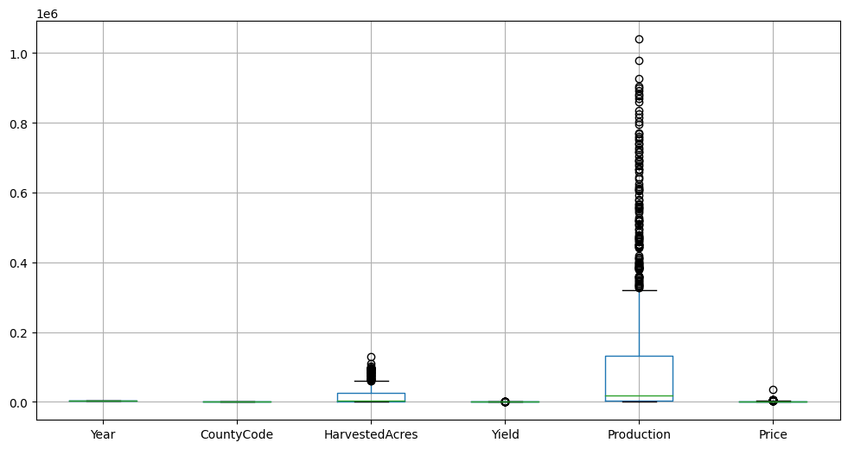
BOX PLOT OF DATASET

Slide 8
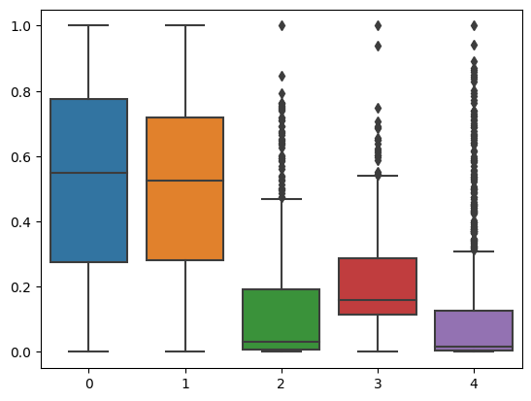
BOX PLOT OF SCALED FEATURES

Slide 9
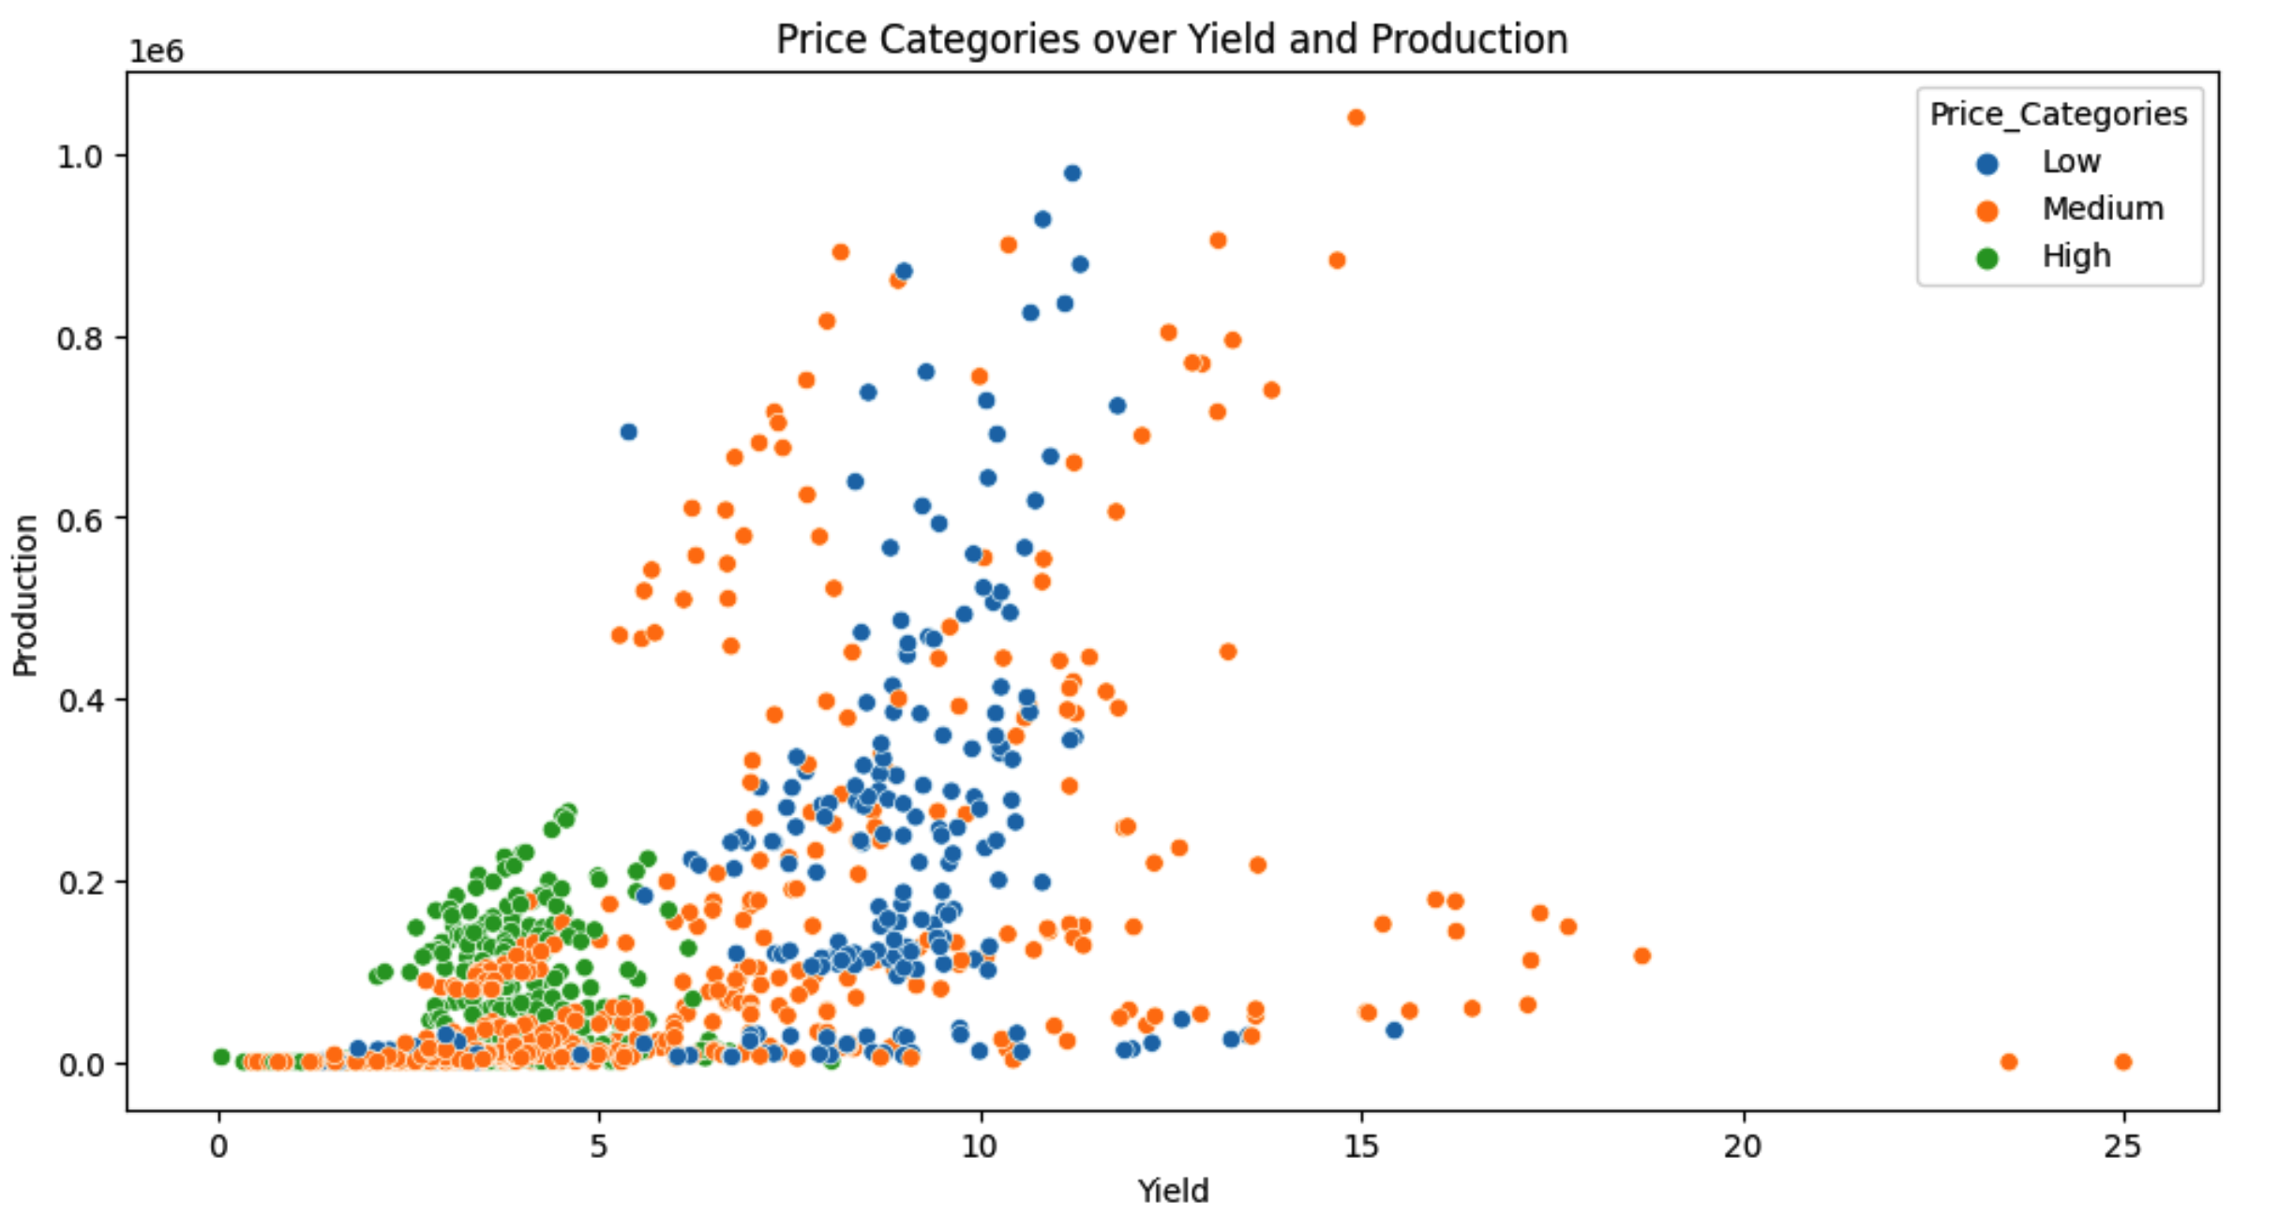
SCATTER PLOT OF PRICE CATEGORIES
Notes:
Sup

Slide 10
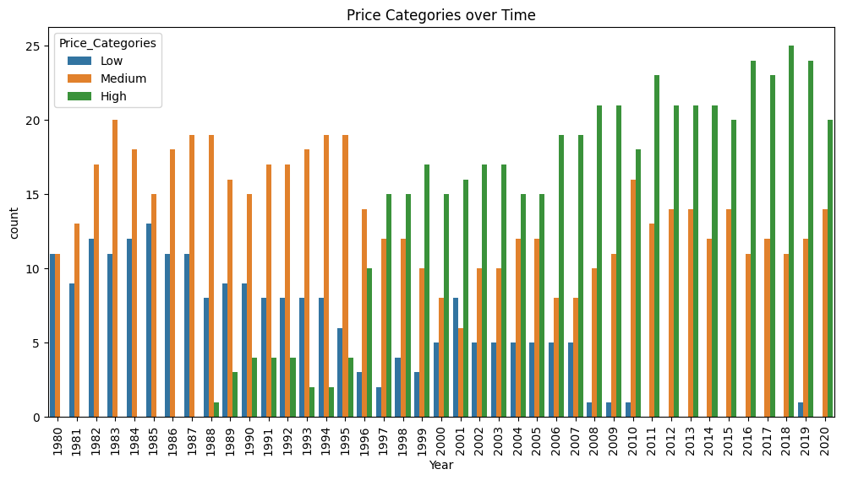
COUNT PLOT OF PRICE CATEGORIES OVER TIME
Notes:
Sup

Slide 11
Random Forest Classifier
Random Forest with Randomized Search CV
Logistic Regression with Grid Search CV
Support Vector Classification with Grid Search CV
K Nearest Neighbors with Grid Search CV
AdaBoost Classifier
Decision Tree
Naive Bayes
Artificial Neural Networks
XGBoost Classifier
Gradient Boosting Classifier
Stochastic Gradient Descent
CLASSIFICATION ALGORITHMS IMPLEMENTED
Notes:
Aryan

Slide 12
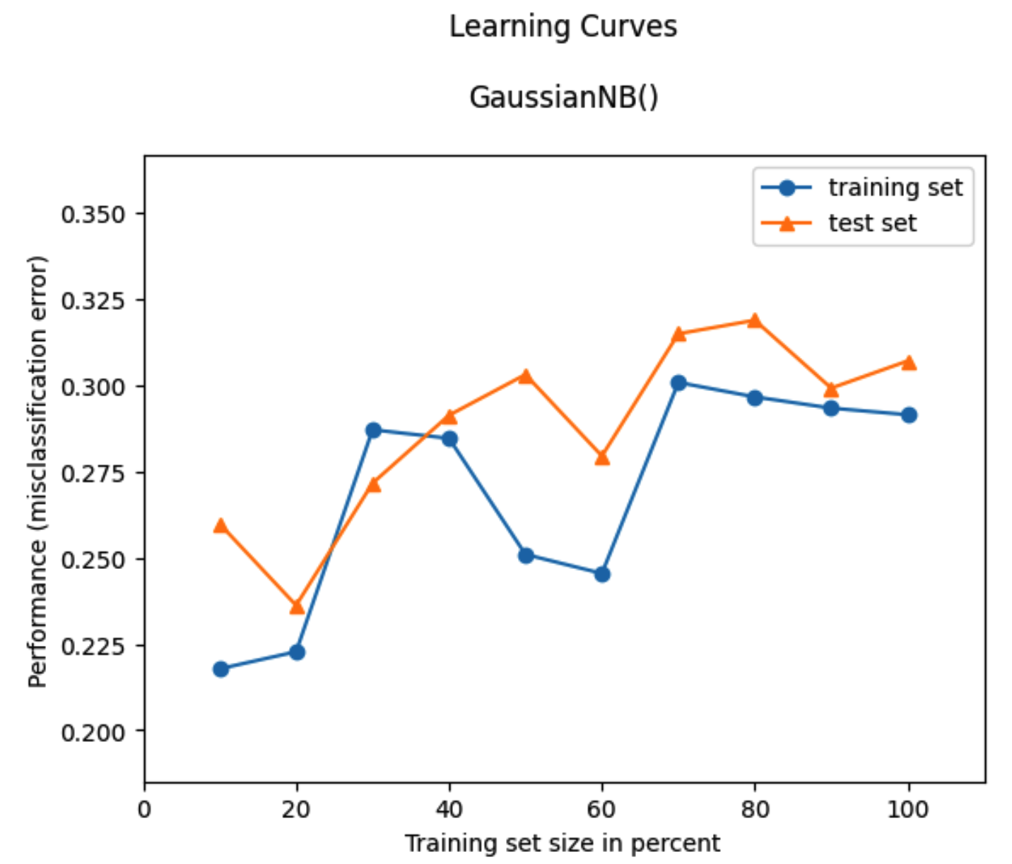
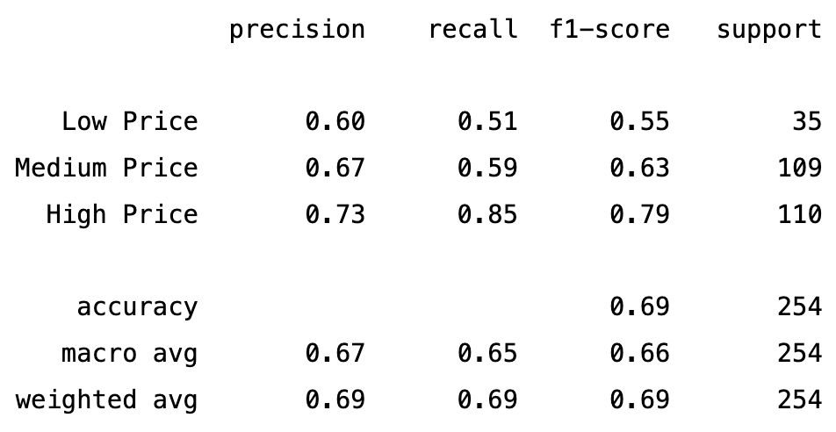
NAIVE BAYES

Slide 13
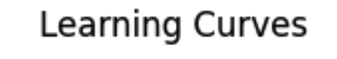
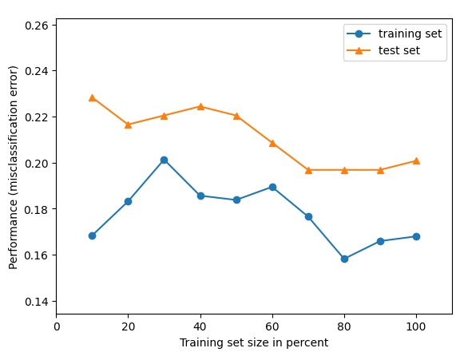
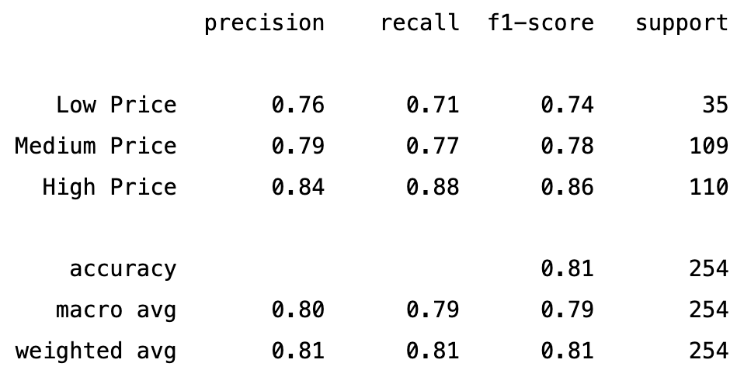
SVC WITH GRID SEARCH CV

Slide 14
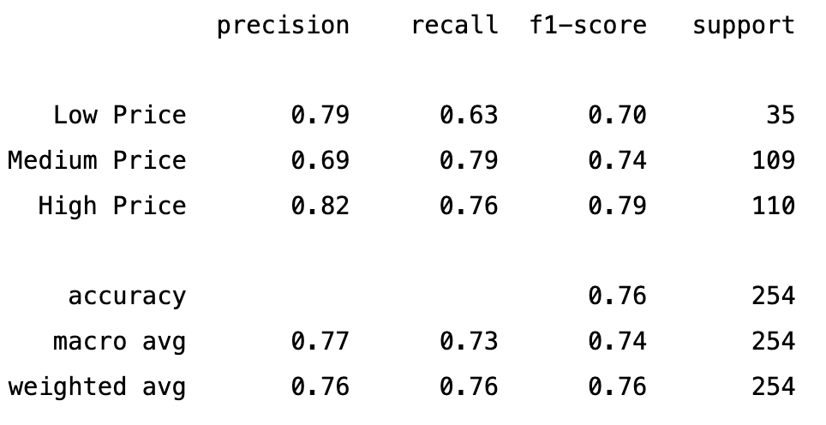
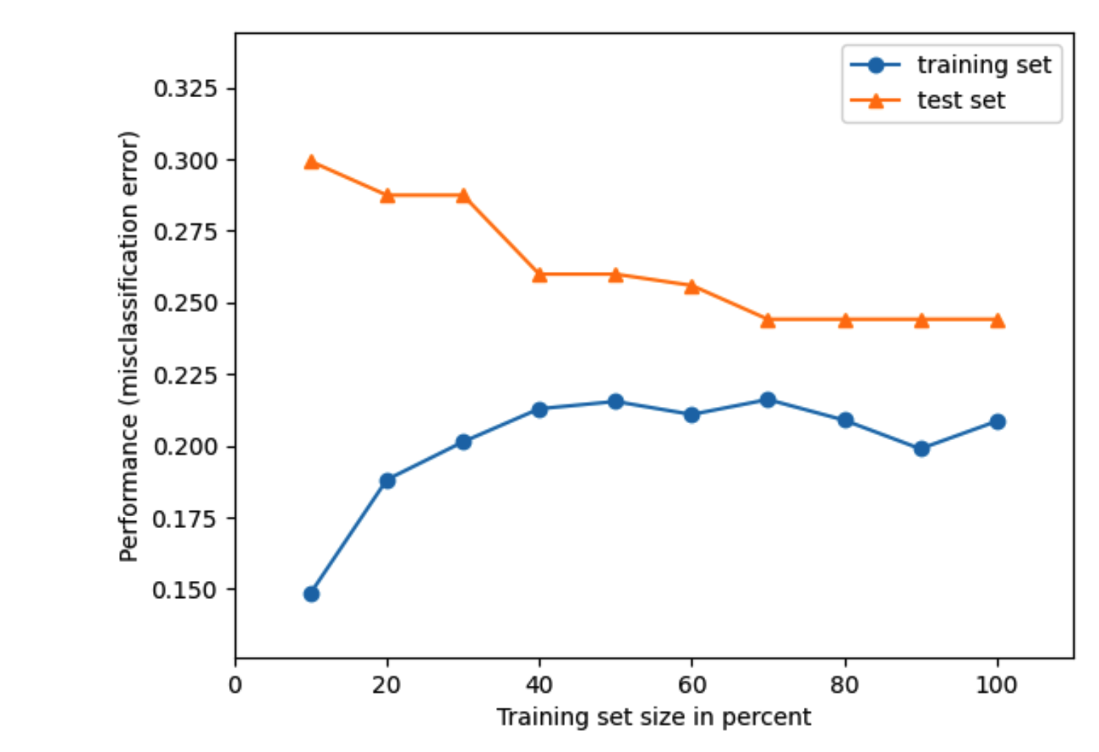
LOGISTIC REGRESSION WITH GRID SEARCH CV

Slide 15
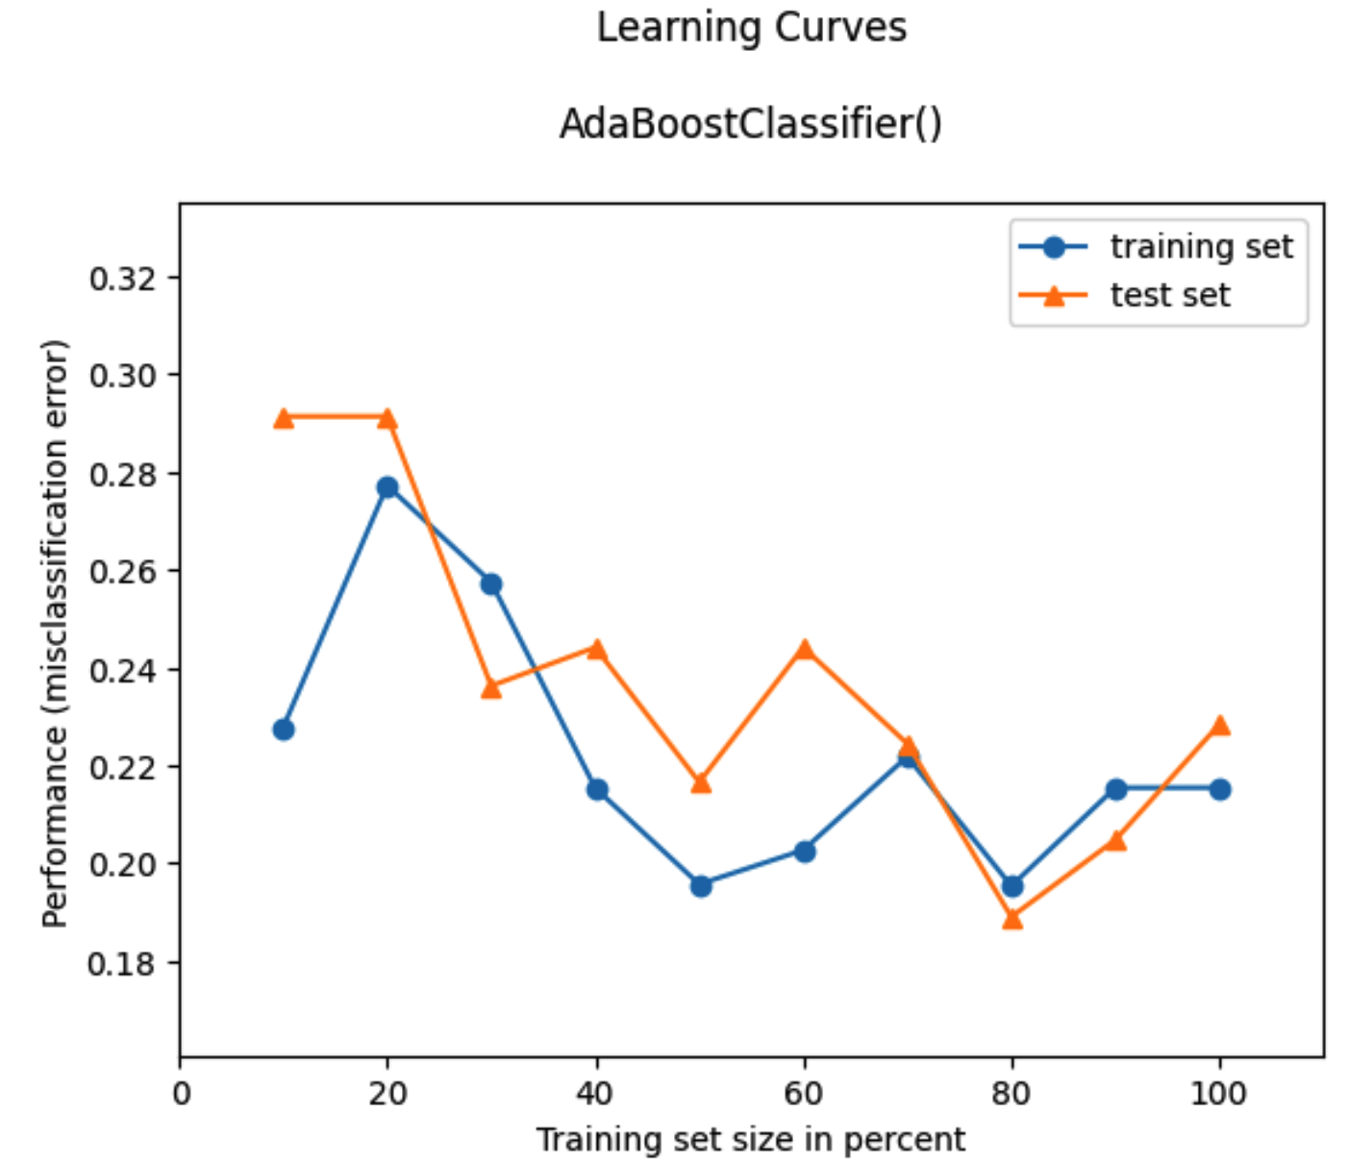
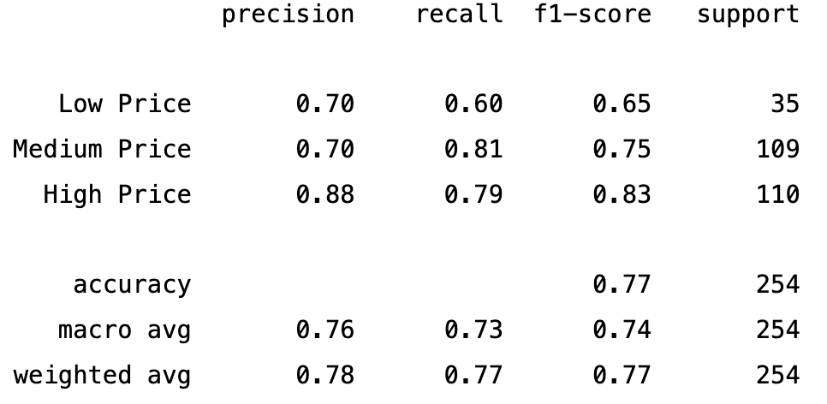
ADABOOST CLASSIFIER

Slide 16
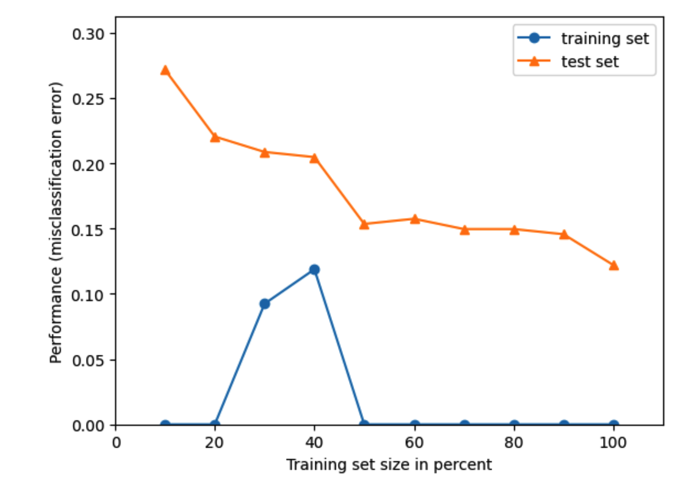
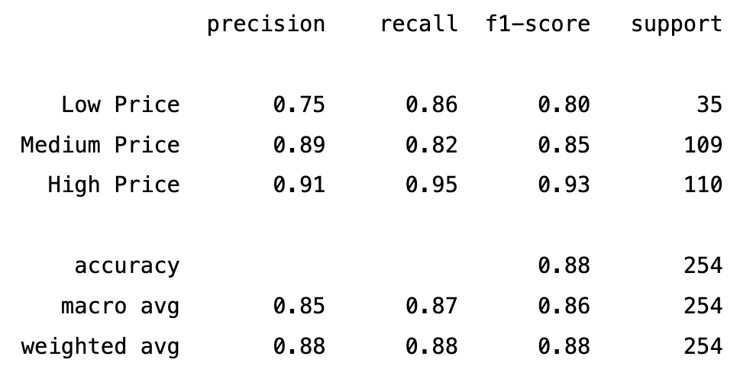
K-NEAREST NEIGHBOR WITH GRID SEARCH CV
Notes:
p

Slide 17
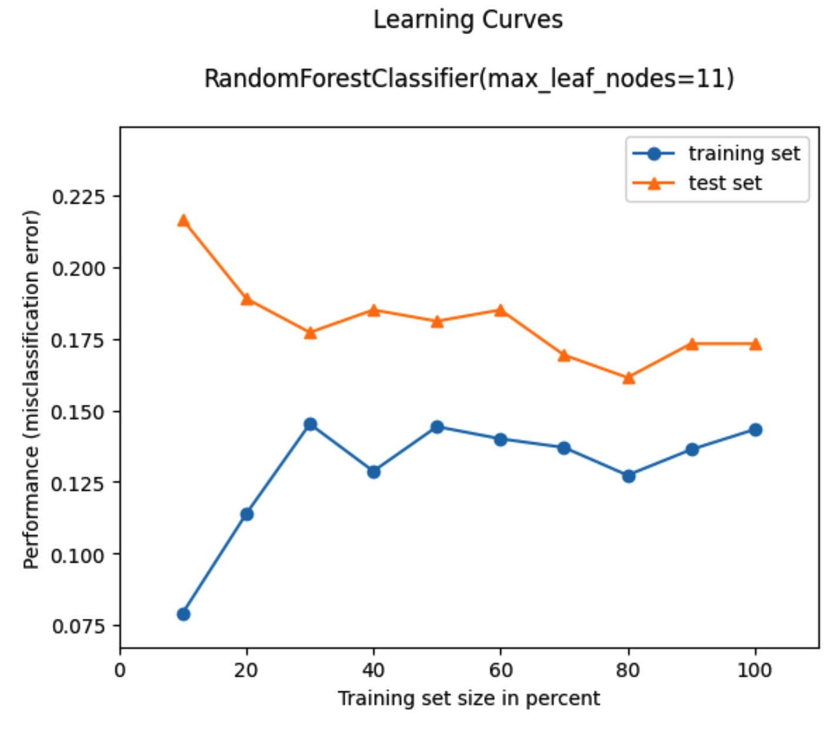
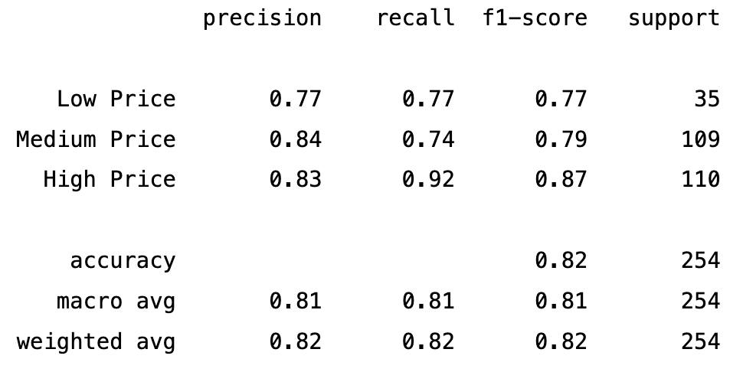
RANDOM FOREST CLASSIFIER

Slide 18
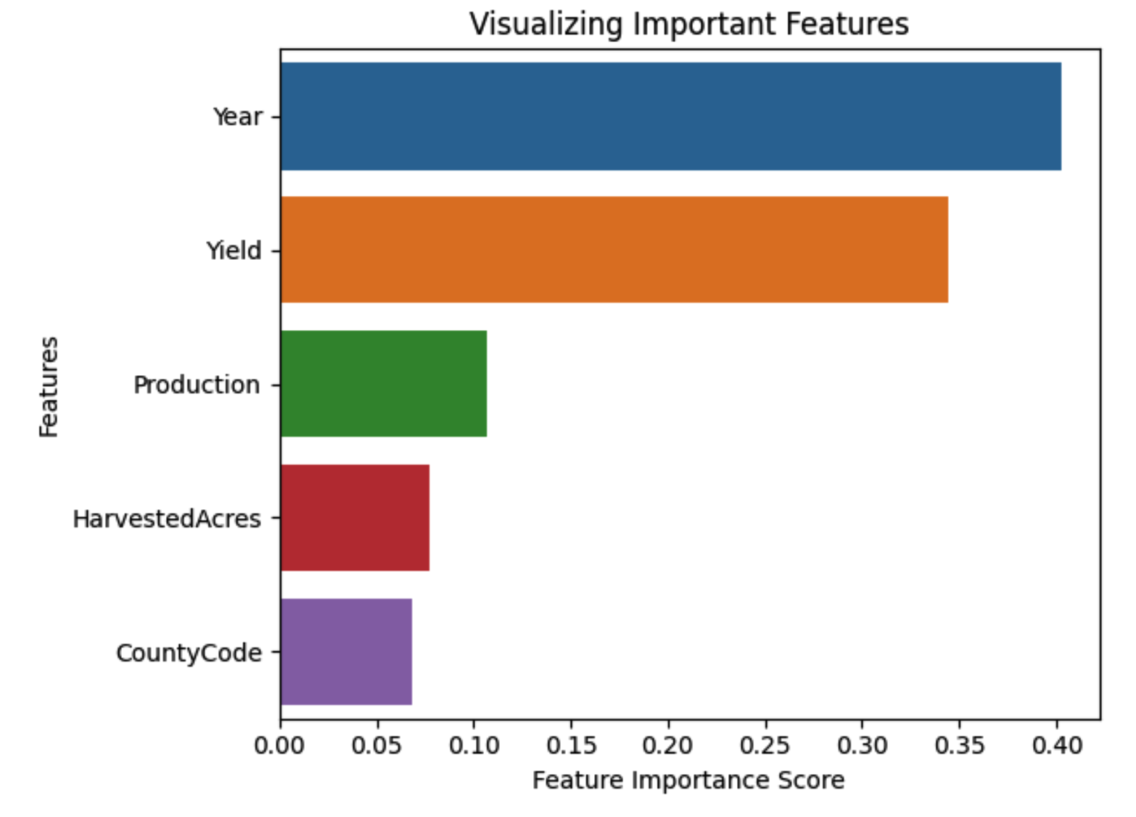
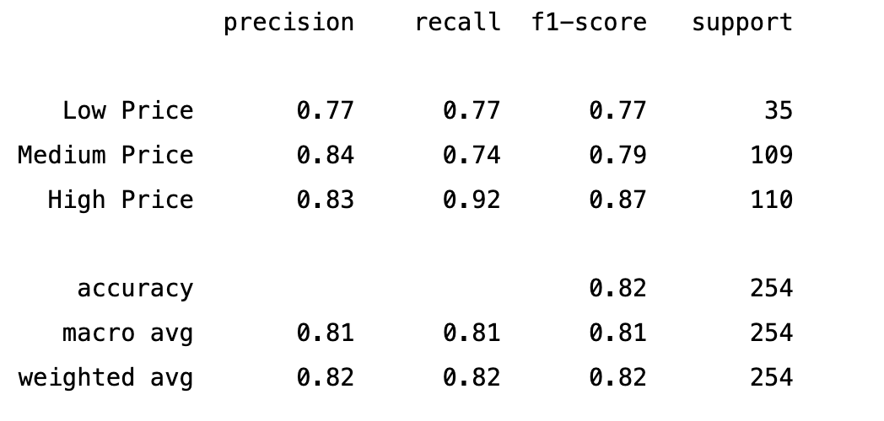
RANDOM FOREST WITH RANDOMIZED SEARCH CV
Notes:
sup

Slide 19
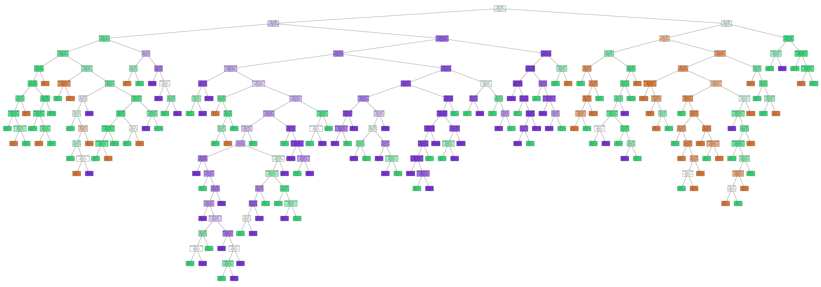
DECISION TREE CLASSIFIER
Notes:
p

Slide 20
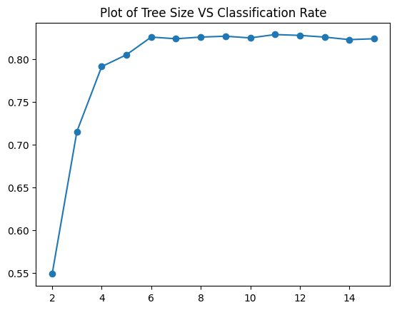
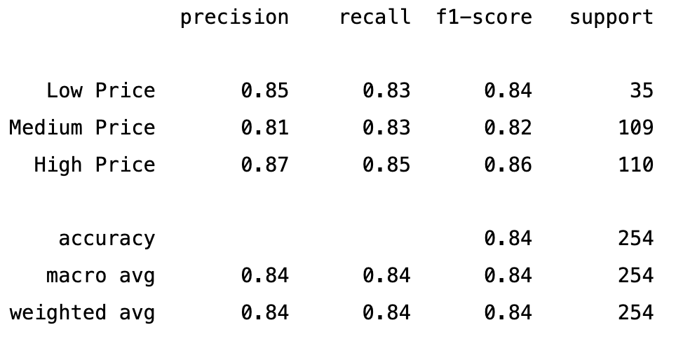
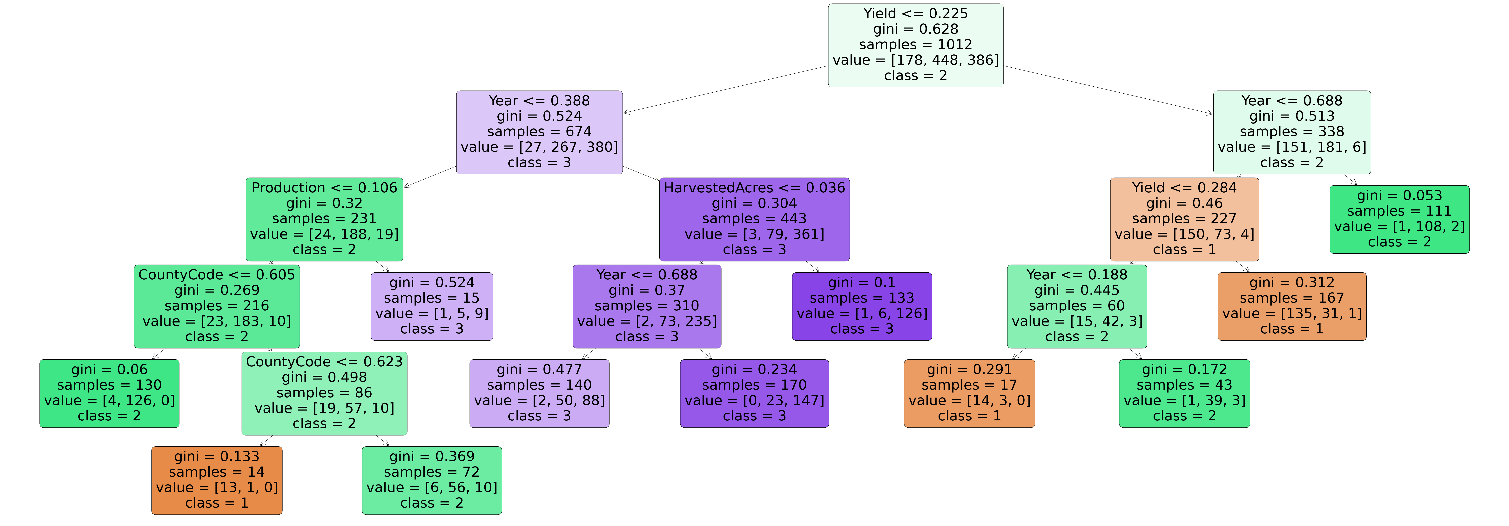
DECISION TREE CLASSIFIER
Notes:
p

Slide 21
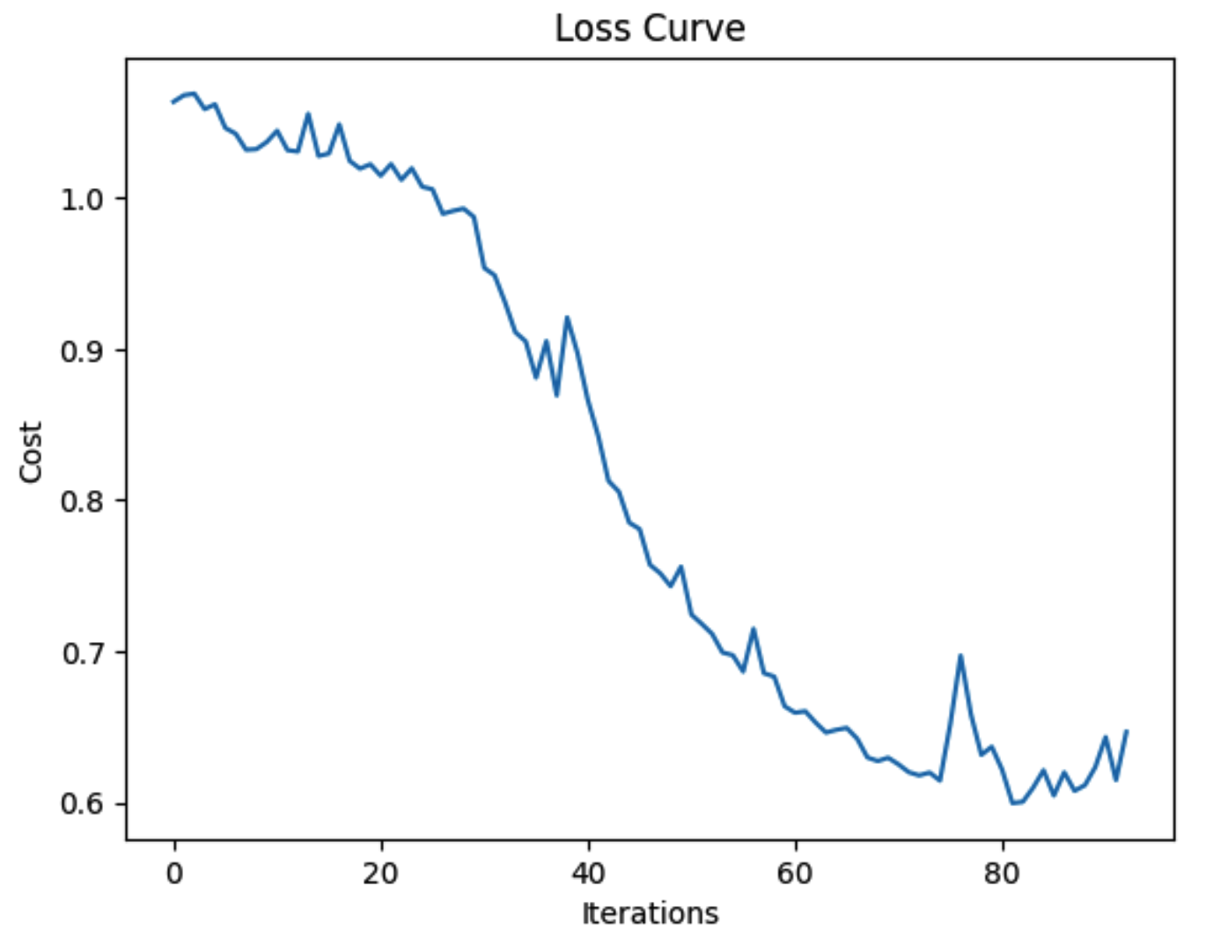
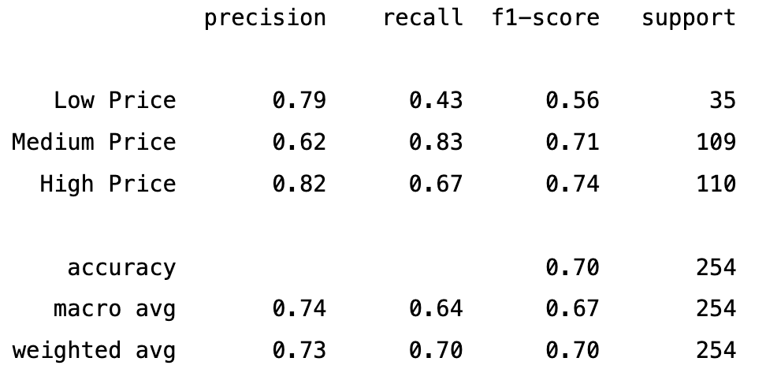
ARTIFICIAL NEURAL NETWORK

Slide 22
EVALUATION METRICS
Notes:
Aryan

Slide 23
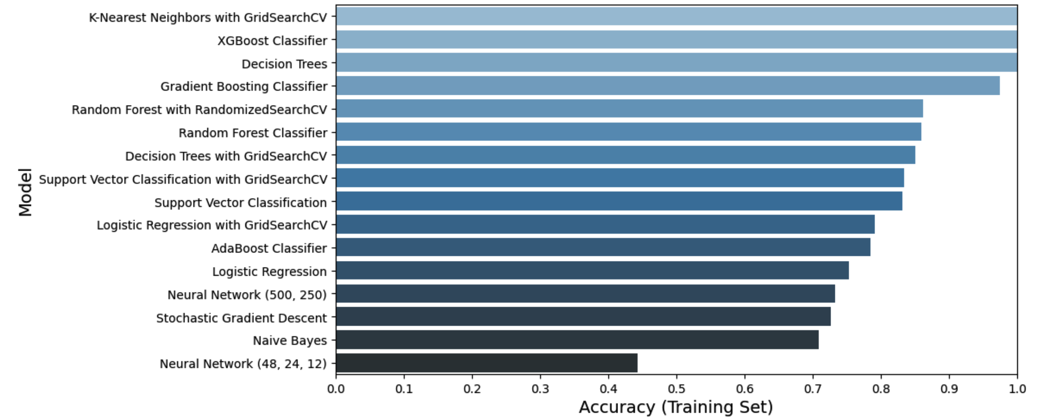
ACCURACY COMPARISON OF MODELS

Slide 24
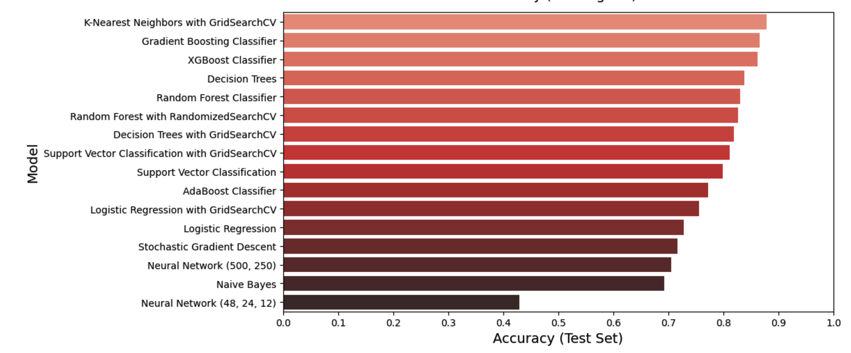
ACCURACY COMPARISON OF MODELS

Slide 25
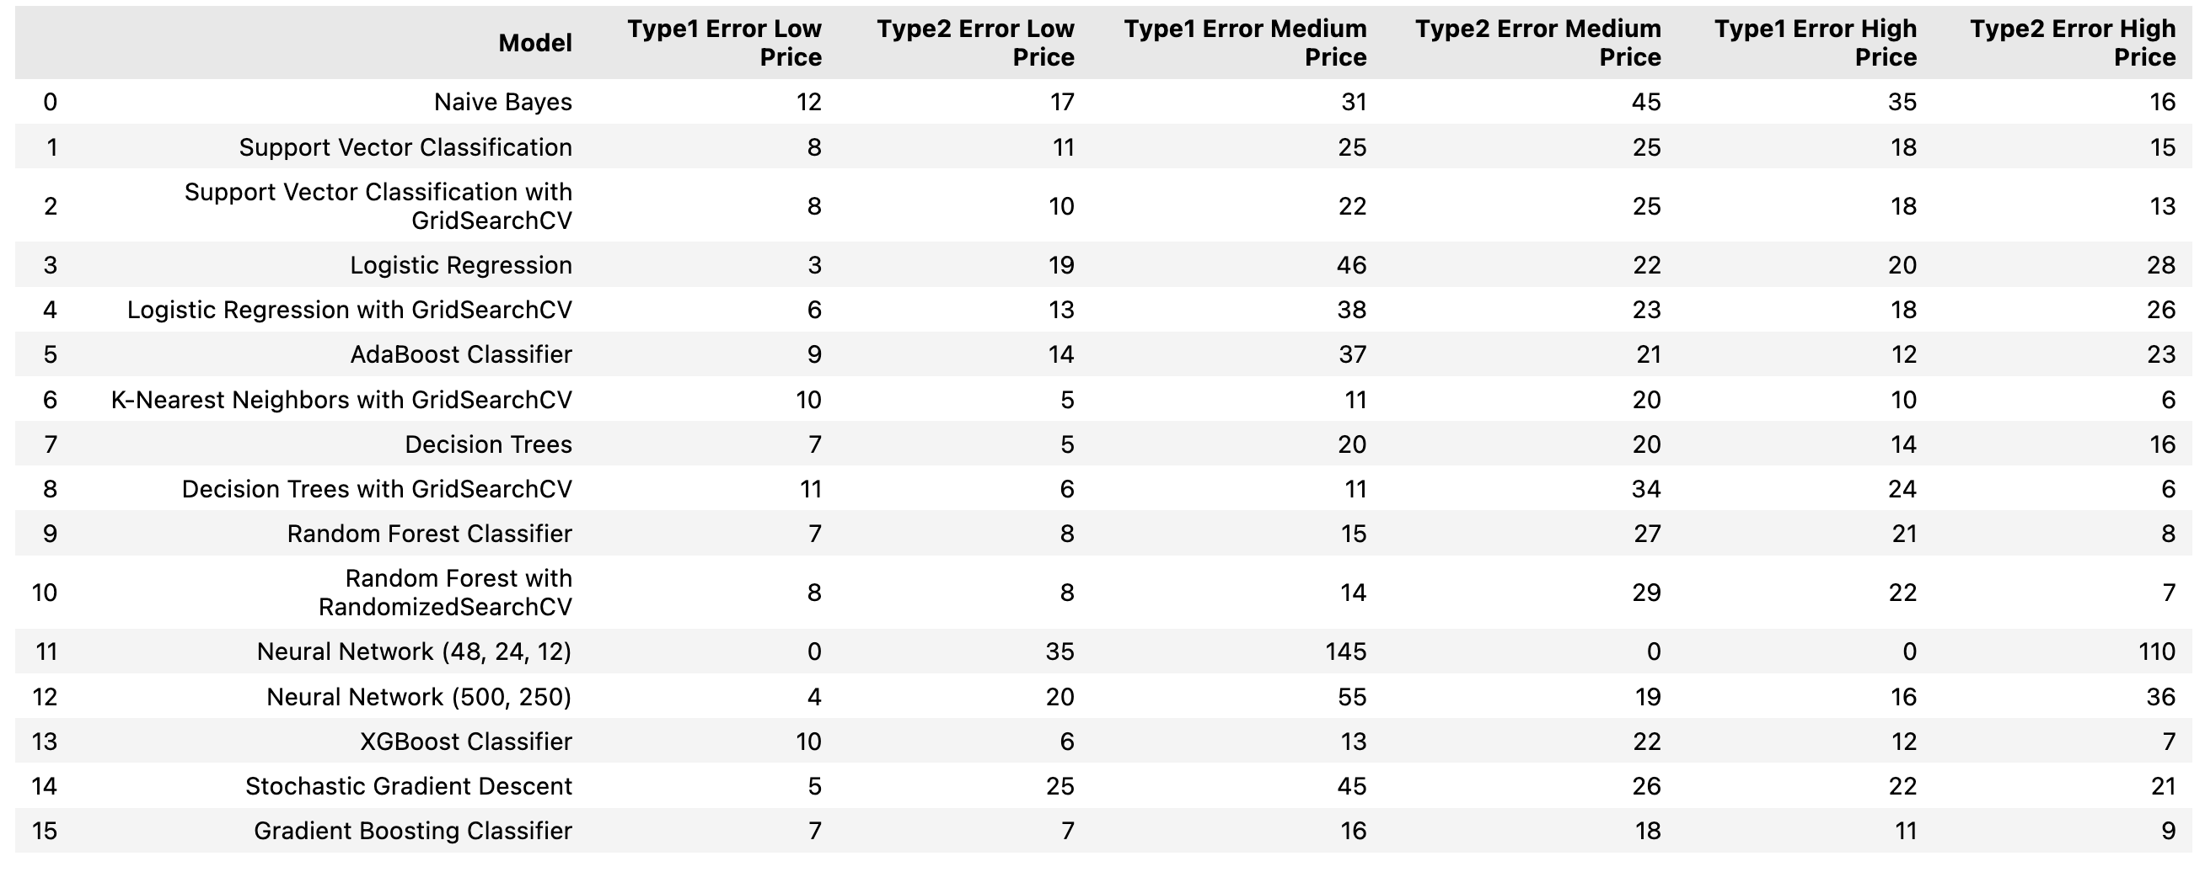
TYPE 1 AND TYPE 2 ERROR

Slide 26
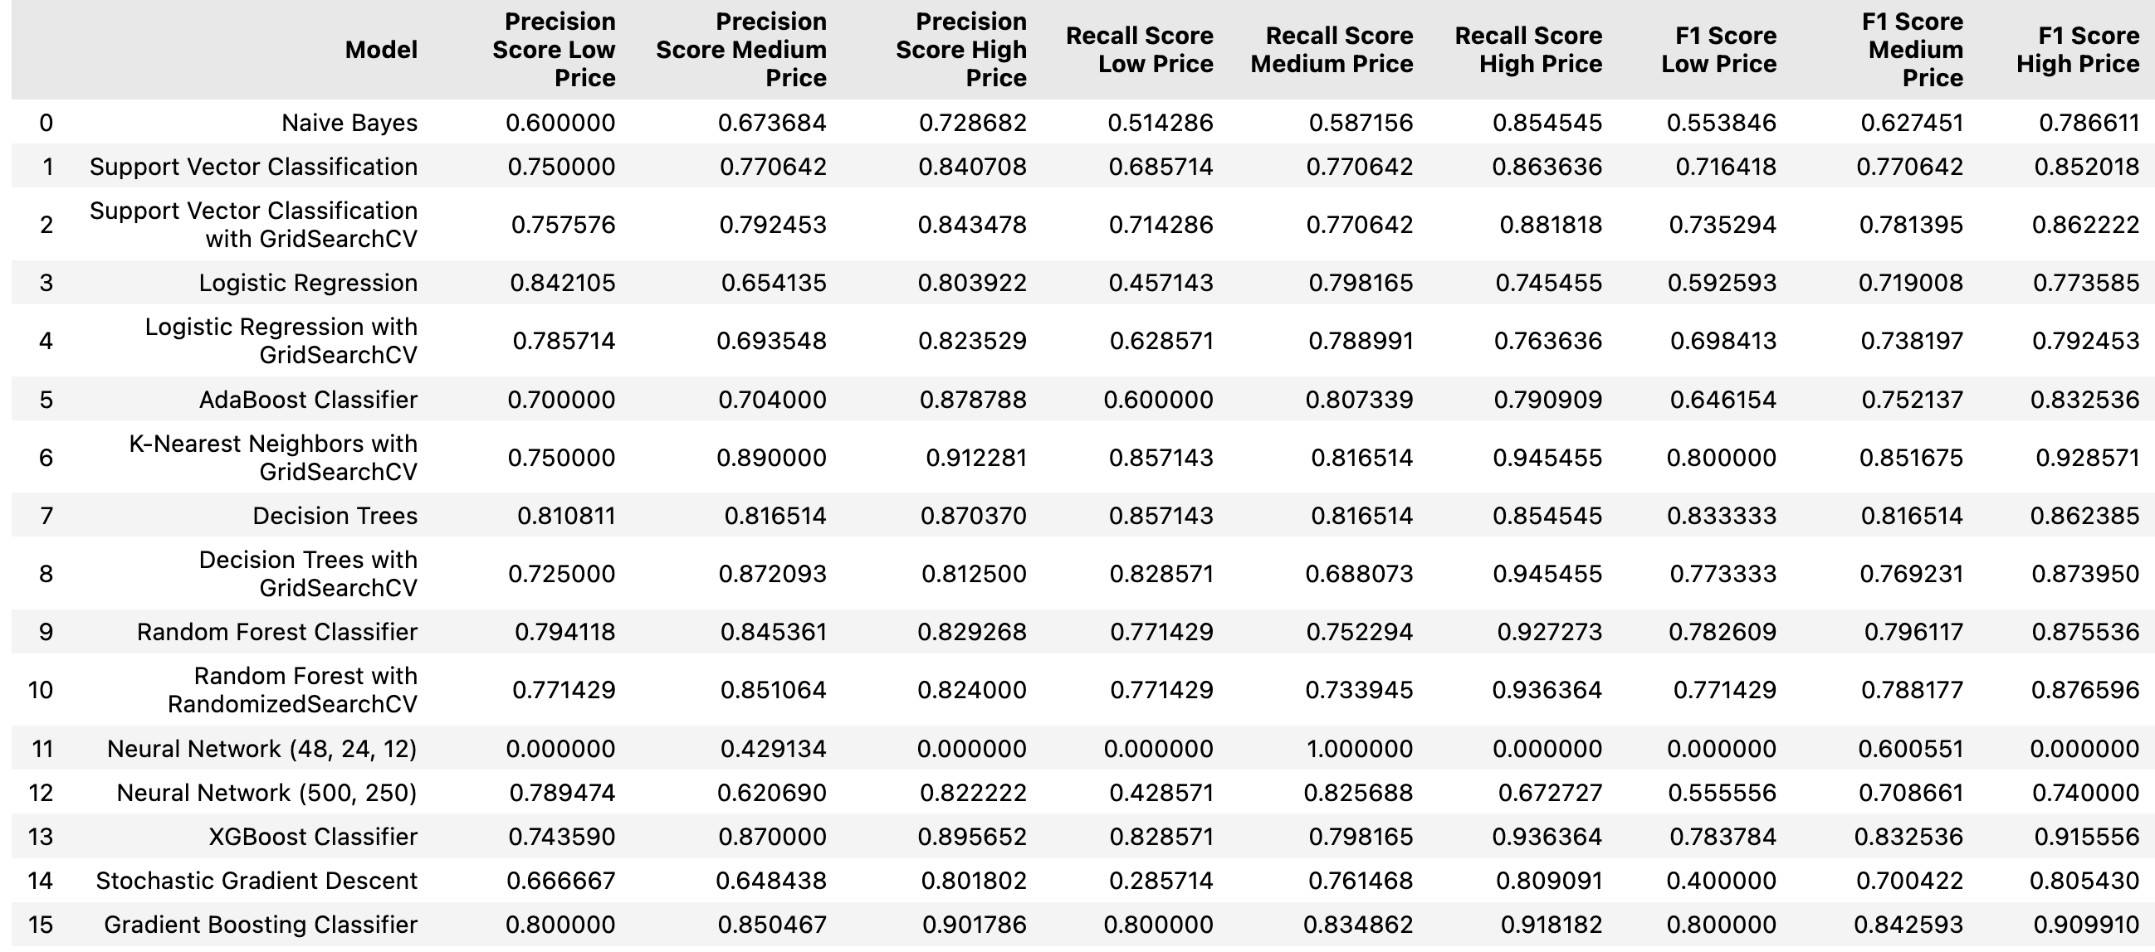
PRECISION, RECALL, AND F1 SCORE

Slide 27
CONCLUSION
KNN with Grid Search CV provided results with highest accuracy, followed by Decision Tree and other classification models.
Notes:
Aryan

